Slide 1
The Capital And Loss Assessment under Stress Scenarios (CLASS) model, 2015
Beverly Hirtle
Anna Kovner
James Vickery
Meru Bhanot
Federal Reserve Bank of New York
Sahil S. Ghurye

Slide 2
Financial Crisis
2008 Financial Crisis
Supervisory Capital Assessment Program (SCAP)
Dodd Frank Act
Comprehensive Capital Analysis and Review (CCAR)
European Banks Stress Test

Slide 3
Introduction to CLASS model
Top-Down Capital Stress Test
Econometric Models
Auxiliary Assumptions
Public Data

Slide 4
Data
Drawn from Federal Reserve Y-9C for BHCs and FFIEC Consolidated Reports (Call reports) for commercial banks for balance sheets, Income and loan performance
Quarterly from 1991 to Q3 2013
All US Head Quartered Banks, top tier BHCs and independent commercial banks
6 large foreign owned BHCs subject to CCAR
Panel of 200 largest banks ; All others are pooled together to form a 201st bank

Slide 5
CLASS Model
Projections of Commercial Bank and Bank Holding Company income and capital under macroeconomic scenarios
Based on Regression of components of Bank Income, Banks Expense and Loan Performance
Assumptions about provisioning dividends, asset growth and other factors
Relies on public information unlike CCAR, DFAST, European Stress Test
Uses 22 regression equations to predict Net Income
Used Auto Regression in all regressions and uses OLS

Slide 8
CLASS Model Contd.
Banks most likely to see a decline in capital under stressful economic scenario also have high current capital ratios; banks holding risky assets also hold high capital buffers
Regression data used to project various financial ratios (Net interest Margin, net charge off rates), conditional on macro data
Ratios are converted to dollar values by multiplying loan balances, securities balance, or assets
Loss, revenue and expense projections used to project pre tax net income
Assumptions about dividends, taxes and regulatory capital rules along with growth of risk weighted assets give us capital and capital ratios

Slide 9
Regression Equation Structure
Each Regression model
Key income or expense ratio as a function of autoregressive term
Set of macroeconomic variables
Some are times series
Ratio_{t}= α + β₁ * ratio_{t-1} + β₂ *Macro_{t} + ξ_{t}
Ratio_{t} is financial ratio of interest, ratio_{t-1} is autoregressive term
Some models are estimated using pooled data (NIM, AFS)
Ratio_{t,i}= α + β₁ * ratio_{t-1,i} + β₂ *Macro_{t,i} + β₃ *X_{t,i,}+ξ_{t}
X is a vector of firms specific characteristics
Autoregressive implies that projected ratio converge slowly towards a long run steady state value

Slide 11
Net Income Formula
Assumptions –
Realized Gain/Losses on HTM Securities and Extraordinary items and other adjustments are zero.
Minority Interest = Previous Period

Slide 12
Pre Provision Net Revenue (PPNR)
Net Interest Income
+ Net Interest Income ( Eg. Interest Income – Interest expense)
Non Interest Non Trading Income Ratio
+Non Interest Income ( Eg. Deposit fees, fiduciary activities, IB fees and insurance)
Non Interest Trading activities
+Return on Trading Assets ( Eg. Derivatives, spread income on trading)
Non Interest Expense
-Compensation Noninterest Expense ratio
-Fixed Asset Noninterest expense ratio (eg. Premises use)
-Other Noninterest Expense ratio

Slide 14
Correlations for PPNR
Variable | Correlation 1 | Correlation 2
Net Interest Margin | Short term Yield | Slope of yield Curve
Trading Returns | Credit spreads (BBB – 10 year) | -
Non trading non interest returns | Stock markets returns | -
Compensation Expense | Stock returns | -
Non Interest expense | Credit Spreads | -

Slide 16
Net Charge Offs (NCOs)
Residential Real Estate | Commercial Real Estate | Commercial and Industrial | Consumer Loans | All Other Loans
First Lien Residential | Construction | Commercial and Industrial | Credit Card | Foreign Governments
Junior Lien Residential | Multifamily |  | Other Consumer
Home Equity Line of Credit | Non Farm Non residential |  |  | Depository Institutions
Other Real Estate |  |  |  | Agriculture
 |  |  |  | Other

Slide 18
Net Charge Off Rates (Contd.)
Real Estate loans related to real estate price downturns
Mortgage default represents a put option on underlying real estate (Kaul et al, 1992)
Real Estate declines have larger effect on charge off rates than real estate price increase
Final Equation Includes dummy variable to check if Price Index is less than 0
Others related - Unemployment Rate

Slide 19
Net Charge Off Rates Correlation (Contd.)
Variable | Correlation 1 | Correlation 2
Residential Real Estate | Home price growth | Home price growth if growth is negative
Commercial Real Estate | Commercial Property Price growth if negative | -
Commercial and Industrial | Annualized Change in unemployment | -
Consumer Loans | Annualized Change in unemployment | -
Other loans | Annualized Change in unemployment | Commercial Property Growth

Slide 21
Available for Sale Securities (AFS)
Firm sells assets or securities deemed to have experienced Other than temporary impairment
AFS low and stable except during 2008-2009
Affected by
Credit Factors
Asset Price Shocks
Credit Events
Behavioral Decisions about Asset Sales
Accounting Judgement
Model includes interaction term between risky AFS securities and increases in Credit spread
Negatively correlated to changes in Treasury Bond yields

Slide 25
Calculating Capital Gap (Common Equity/Risk Weighted Assets)
Capital Gap is the capital needed to bring each BHC to a certain capital ratio
Compute and estimate of system wide undercapitalization ($100 billion in 2002 and $540 billion in 2008) assuming 8% threshold
Capital gap falls significantly after 2009
Equity Issuance by firms
Lower Dividends
Return to profitability

Slide 27
Previous Graph
Between 2004 Q1 and 2008 Q4, Assets increased by 33% but Capital Gap increases by 83% ($113 Billion to $206 Billion)
Signifies deterioration of capital adequacy in years leading up to crisis
Seen nearly 4 years before
$8.5 Billion in 2013 Q3 significantly lower than 2002 also!
Shows that’s banks are better capitalized now.

Slide 28
Assumptions - Balance Sheet Growth
Total Assets – 1.25% per Quarter
Banking Industry grows more slowly in stressed Environments than expansion
Banking Sector moves with Macro economy historically particularly with Term Spread and Credit Spread
Increase in Term Spread – Shift from Loans to Securities
Increase in Credit Spread – Shift from trading assets and fed funds to cash and securities portfolio

Slide 29
Assumptions - Allowance for Loan and Lease Losses (ALL)
Model projects NCOs for each quarter
Under accounting rules, NCOs don’t affect Net Income and instead recognize provision expense incurred to increase Allowance for ALLL
ALLL is estimated by firm and hence needs management discretion it’s not straight forward; Hence CLASS Model assumes range
If ALLL is at least equal to next 4 quarters of projected NCOs, but not greater than 250%, Provision expense is equal to NCO
If ALLL is below next 4 quarters NCOs, Provision expense is equal to amount that would bring ALLL to that level
If ALLL is greater than twice next 4 quarters NCOs, then Provision expense is negative to bring ALLL down to that level

Slide 30
Assumptions - Taxes
Banks are Assumed to pay 35% statutory Tax rate
There are limits that Deferred tax assets can be carried forward

Slide 31
Assumptions - Dividends
Change in Equity is determined by Net Income and Capital Actions like:
Dividends on both common and preferred shares
Share repurchases
New Shared Issuance
No share repurchases or issuances
Assumes Dividends converge to payout ratio, averaged to 40-50% of net after tax
Dividends_{t}=max(a*Dividends_{t-1} + (1-a)*[Dividends_{t*} - Dividends_{t-1}],0)
Dividends_{t*}=45% * After Tax Net Income
a= Speed of Adjustment parameter (0.9)

Slide 32
Sensitivity to Assumptions
Asset Growth Rate Assumed at 1.25%
Sensitivity done at -01.25%, 0.00% and 2.50%
Loan Loss Provisioning Rule
Sensitivity to 4 Quarter rule setting ALLL equal to next 4 quarter of NCOs
Payout Rule
Sensitivity – Dividends remain same, benchmark rule (45%), Dividends are equal to zero
Firms must have a tier 1 common ratio above 6
Tier 1 common ratio = (Common Stock + Retained Earnings + Accumulated other comprehensive income + Non cumulative perpetual stock) / Weighted Risky Assets

Slide 33
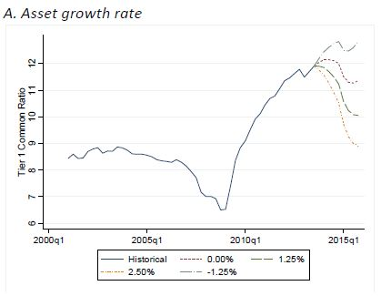
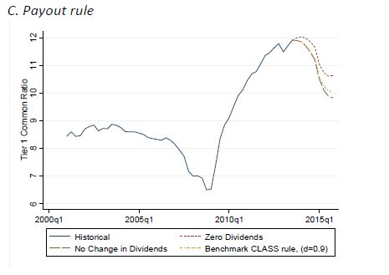
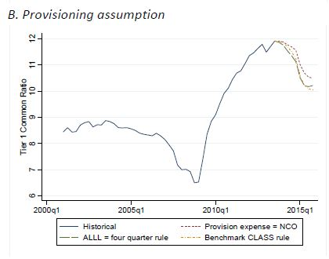

Slide 34
Comparing CLASS and CCAR projections
 | CLASS Model | CCAR
Modeling Approach | Top-down Model | Bottom-up Model
Data | Publicly available from Call and 9-YC filings | Detailed supervisory information from individual BHCs
Coverage | Top 200 largest BHCs and independent banks | 30 BHCs with assets exceeding $50 billion
Dividends | Converging to a long-run average payout ratio relative to Net Income | Fixed at recent historic levels and assumes no repurchases
Balance Sheet Growth | Stylized assumptions for all institutions in all scenarios | Various across institutions and scenarios
Trading and Counterparty | Trading revenues based on macroeconomic scenarios | Separate instantaneous global market shock on 6 largest BHCs

Slide 35
Shortcomings
No feedback from banking system to Macro economy
Macroeconomic projections are treated as exogenous
Used to predict Net Income and Regulatory Capital under certain macroeconomic scenario
Shouldn’t be used for a specific bank or BHC

Slide 36
Why is it useful?
Model projections can be generated quickly by adjusting assumptions
Can be used as a benchmark against other top-down models
Show vulnerability as back as 2004, before any market indicators
Can use recent data to project income and capital in a few minutes for a single macroeconomic scenario
Use fed data to test for various scenarios (Next Slide)
Can be improvised and developed

Slide 37
Fed Data

Slide 38
Thank you!
Sources :
https://www.newyorkfed.org/medialibrary/media/research/staff_reports/sr663.pdf
https://www.federalreserve.gov/supervisionreg/ccar-2017.htm

